Slide 1


PaySlash
UPI based payment without internet utilization through a mobile app
By Team AppSlash

Slide 2
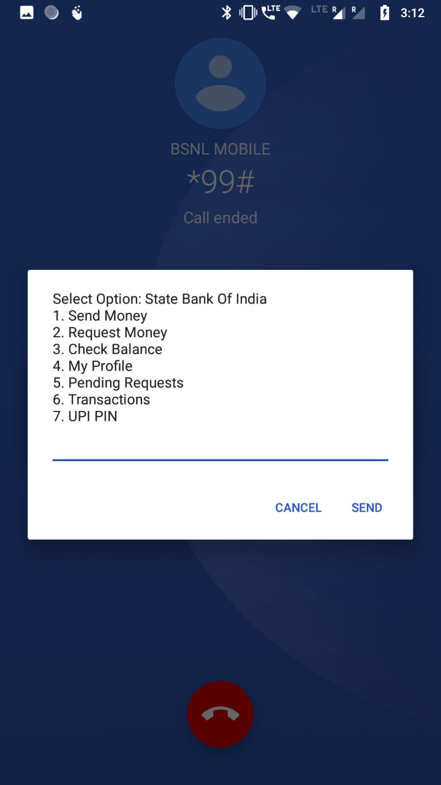
Challenges :
At present this service depends on the payer to remember the various USSD codes, payee's details and manually dial/input them make at the time of checkout.
Availability of such an application will facilitate cashless transactions where internet is not available at adequate bandwidth to support internet-based payment transactions.

Slide 3
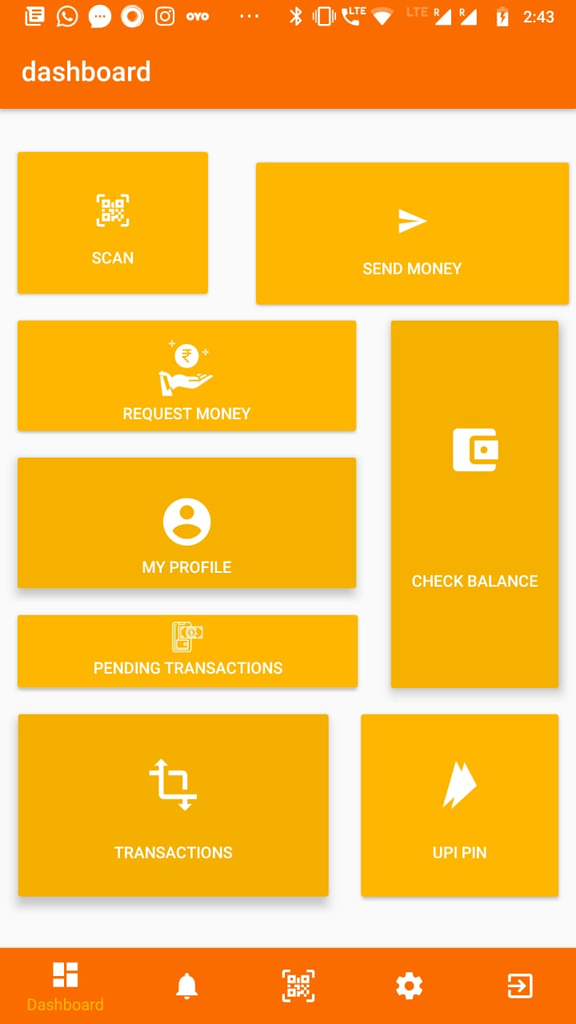
The Solution :
Leverages the available Unstructured Supplementary Service Data (USSD) service already available for making UPI payments through the registered phone number over GSM without the use of internet.
Our idea provides an offline application that will have an interface for users to easily comprehend and use this platform for making transactions.

Slide 4
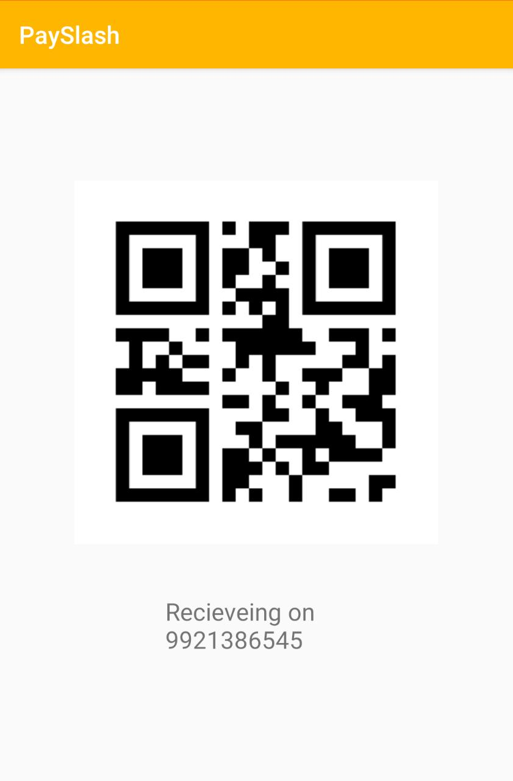
Use Case Flow :
Payee shows a QR Code to Payer through their phone screen or a sticker at their retail shops, This QR Code has UPI address of the Payee.

Slide 5
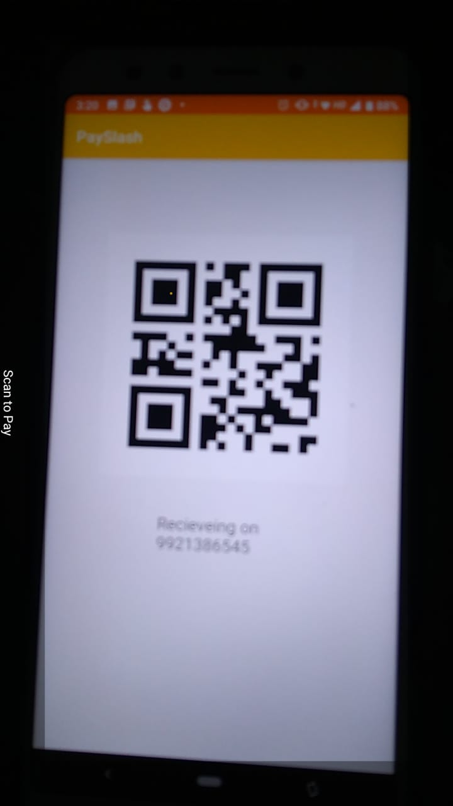
Use Case Flow :
The application installed on Payer’s phone scans this and initiates the transaction followed by a series of inputs to confirm amount and UPI pin of the payment.

Slide 6
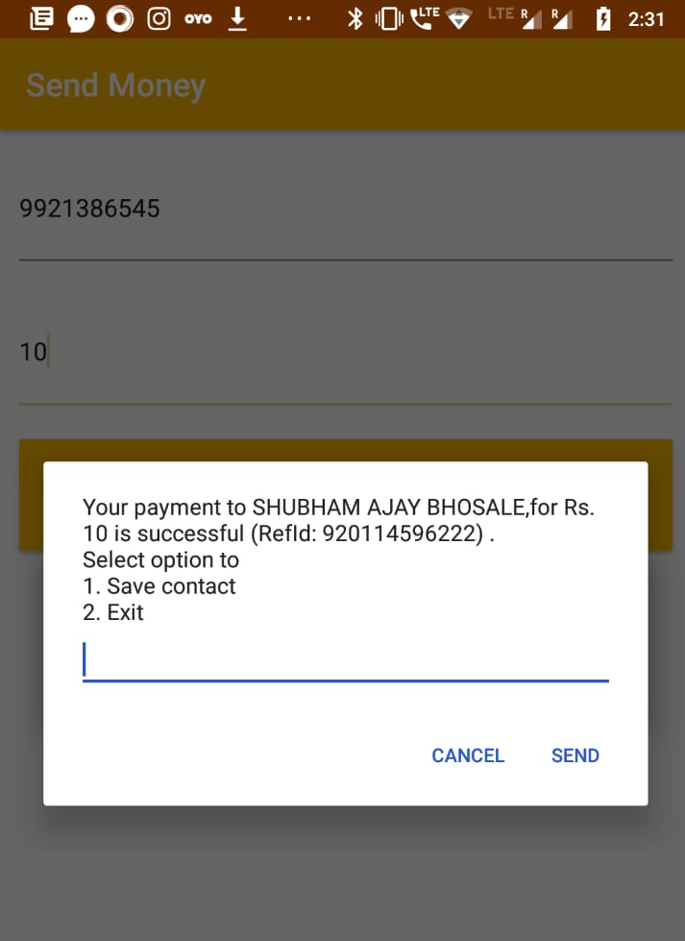
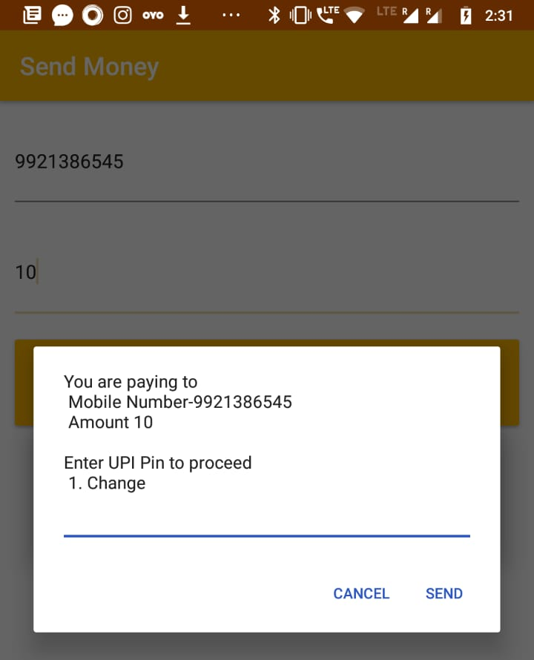
How it works :
The application achieves this transaction session by dialing UPI service phone number 99# from the registered phone number and as this application is to use the registered phone number at its on-the-go usage. It confirms that the transaction is being performed by a valid user’s registered number (SIM card).

Slide 7
Thankyou ☺

